Slide 1

Analysis of past 120 years of Olympic Games
Group 3: AVI, Jelena, HoHsin (Heidi), Soumya

Slide 2
Outline
Main question
Data preparation process
Analysis outcome
Conclusion
  Data limitations and assumptions
  Learnings and takeaway

Slide 3
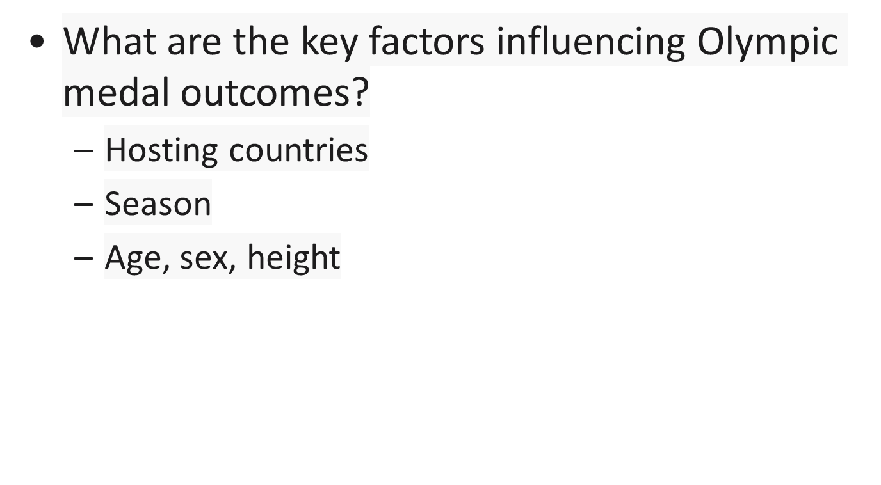
Main Question
Notes:
Based on the data we have, we can focus our analysis based on the following factors – hosting countries, the s

Slide 4
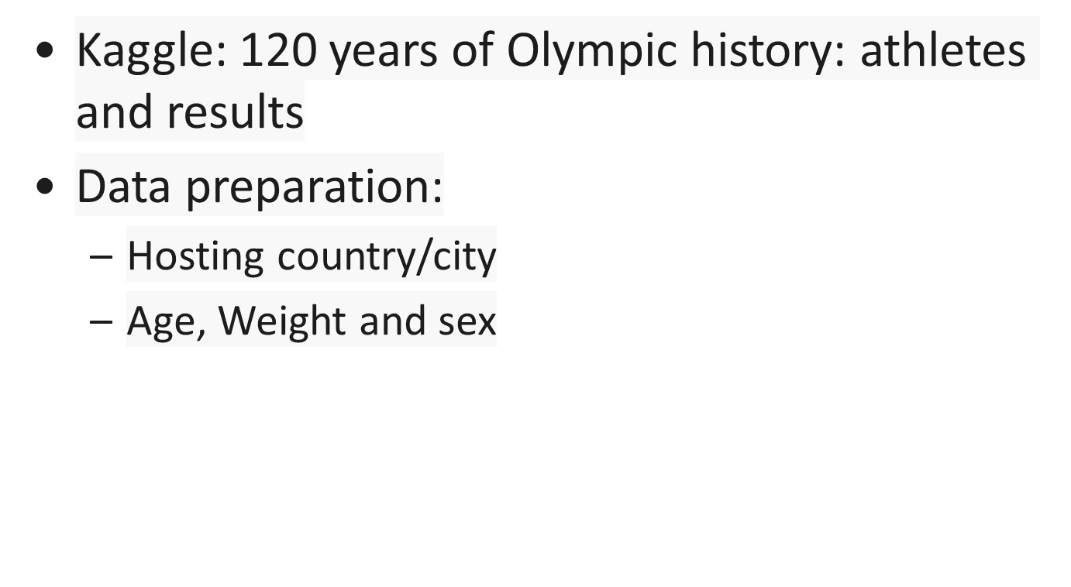
Data Preparation Process
Notes:
The summer Olympic is going to be in France and we think it is interesting to do some analysis based on past 120 years data. What kinds of information is included in the data? (This is a historical dataset on the modern Olympic Games, including all the Games from Athens 1896 to Rio 2016. ) Then we decide to break into 2 group – one focus on country and the other group focus on athlete

Slide 5

Analysis
Notes:
The summer Olympic is going to be in France and we think it is interesting to do some analysis based on past 120 years data

